Slide 1
Multi-omics Data In The Identification Of Kidney Cancer Subgroups
Supervisor
Dr. Pratheeba J.
By
2018/E/073: Mr. Maduranga W.P.N.
2018/E/102: Mr. Rodrigo S.M.
Co-Supervisor
Dr. Thuseethan S.
EC6070 - COMPUTER ENGINEERING RESEARCH PROJECT

Slide 2
Introduction
Our research is related to the medical field and the goal is to classify the Kidney cancer patients into their clinical subgroups with a better accuracy.
To accomplish that task, we have choose 3 main components known as,
Major subtypes of Kidney cancer
Multi Omics data
Machine Learning
Significance of the Research
Kidney cancer is a common cancer variant at present.
People who are elder than 60 are the mostly affected group and about 79,000 cases identified annually. Usually 14,000 deaths recorded among them.
Fortunately, there are considerable possibilities of get cured, if it can be detected in the early stages.
2
Notes:
Clear cell
Papillary
Chromophobe

Slide 3
State of Art
He, Z., Liu, H., Moch, H. et al. Machine learning with autophagy-related proteins for discriminating renal cell carcinoma subtypes. Sci Rep 10, 720 (2020). https://doi.org/10.1038/s41598-020-57670-y
What they have done? |  | Methods used |  | Gap
They tested the possibility of using autophagy proteins (ATGs), for classification of renal cell carcinomas (RCC). |  | Analyzed data using different data cleaning and a machine learning technique (KNN) to classify the subtypes of RCCs. |  | Single omic data No comparison between machine learning methods Prediction accuracy very low (especially for biological problem) with protein data.
3
Notes:
This is the most recent and very related article.
Optimal K value determined by a 4-fold cross validation
237 RCCs from untreated patients and 18 normal kidney tissues

Slide 4
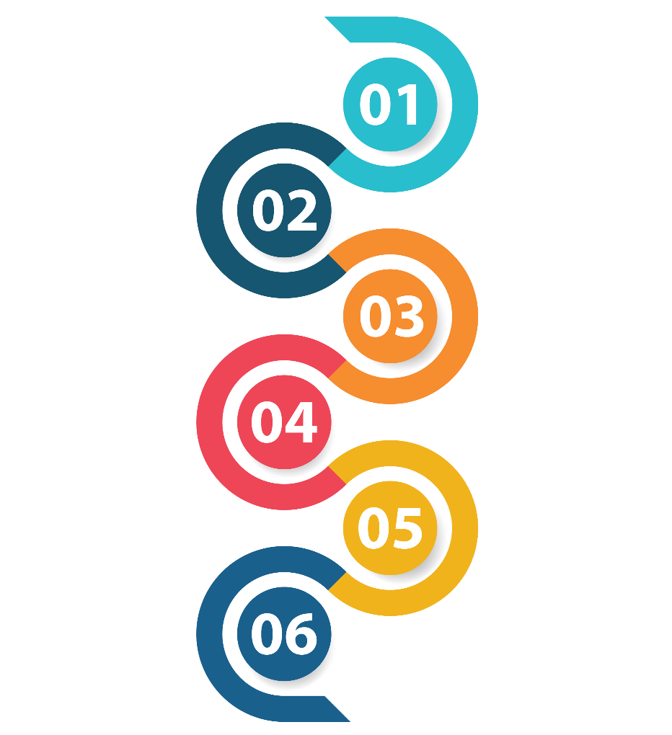
Methodology
Dataset Selection
Data Preprocessing
Feature Selection
Prediction Methods
Comparing the Performance
Finalize the model
4
Notes:
Pearson correlation
Forward feature selection
Backward feature illumination
SVM(Support vector machines)
Logistic regression
K-nearest neighbours

Slide 5
Progress to date

Slide 6
Dataset Selection
We have downloaded the datasets from The Cancer Genome Atlas (TCGA) Data Repository
From TCGA, we got following datasets for each subtype:
DNA methylation (Methylation450k)
gene expression (RNAseq)
protein expression (reverse phase protein array (RPPA))
miRNA (IlluminaHiseq)
6
Notes:
TCGA – a data repository which collected, characterized, and analyzed cancer samples from over 11,000 patients over 15 year period.
Latest techniques that used for analysis

Slide 7
Dataset Selection & Preparation
Omics Type | Number of Features |  |  | Number of Patients
 | KIRC | KIRP | KICH | KIRC | KIRP | KICH
Genomic | 20,530 | 20,530 | 20,530 | 606 | 323 | 91
Proteomic | 273 | 224 | 219 | 478 | 216 | 63
Methylation | 485,577 | 485,577 | 485,577 | 480 | 321 | 66
MicroRNA | 2,048 | 2,114 | 1,917 | 311 | 311 | 89
Have added another row(Subtype)
Assigned a value for Subtype row considering the subtype
KIRC : 0
KIRP : 1
KICH : 2
7

Slide 8
Genomic data

Slide 9
1. Preprocessing

Slide 10
1.1 Data Integration
Concatenate the 3 datasets to combine them
It will merge the datasets considering columns
Can create null values
Shape of the final dataset = (1,020, 20,531)
10

Slide 11
1.2 Data Cleaning
No duplicates found
No null values found
Considerable zero values found
Handled zero values by removing the related feature
Shape of the data frame after removing zeros = (1020, 14575)
11
Notes:
No duplicates found
No null values found
Considerable zero values found

Slide 12
1.3 Feature Selection ( Pearson Correlation )
Got the correlation of each features
Correlations in Label column has taken
Select the best features considering the highest correlation to the label
Done the selection for different feature amounts (200, 150, 100, 50)
12

Slide 13
1.4 Sampling ( Up sampling and Down sampling )
Used both techniques to equalize total rows related to each label value
Before using sampling
KIRC : 606
KIRP : 323
KICH : 91
After using sampling
KIRC : 150
KIRP : 150
KICH : 150
13

Slide 14
1.5 Splitting Data ( Train | Test )
Have used sklearn’s, train_test_split method to split the data as train and test
Ratio between train and test = 4:1
Splitting has done for;
Main dataset
Data frames with different features ( 4 )
14

Slide 15
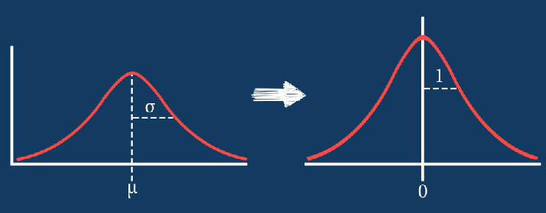
1.6 Data Transformation
Dataset is not in a standard range
To solve that we used Standardization
Probability
Probability
Values
Values
15

Slide 16
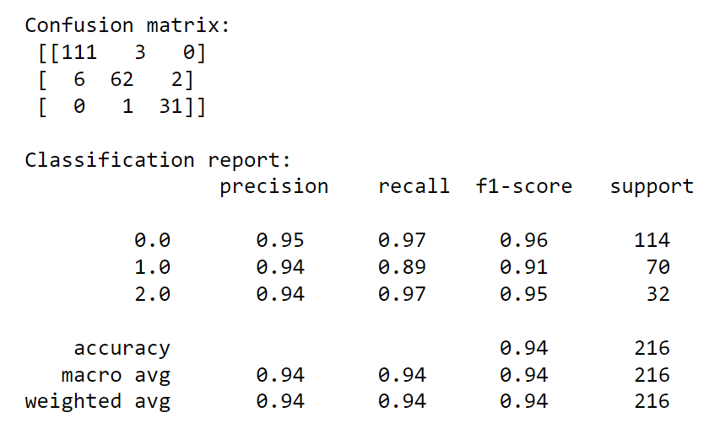
2. Train the model and evaluation
Prediction method: SVM
Evaluation method: Confusion matrix and Classification report
16

Slide 17
3. Results for Genomic data ( Up to now )
Feature selection method: Pearson Correlation
Prediction method: SVM
Evaluation method: Accuracy and F1-Score
No of features | Accuracy | F1-Score
 |  | KIRC | KIRP | KICH
20531 | 0.94 | 0.96 | 0.91 | 0.95
200 | 0.96 | 0.97 | 0.94 | 0.97
150 | 0.96 | 0.97 | 0.93 | 0.96
100 | 0.94 | 0.95 | 0.90 | 0.94
50 | 0.92 | 0.94 | 0.89 | 0.91
17

Slide 18
Protein data

Slide 19
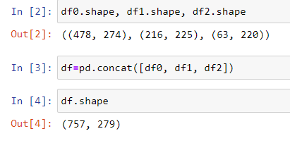
1. Preprocessing
1.1. Data Integration
Concatenated the 3 datasets
Shape of the final dataset
19

Slide 20
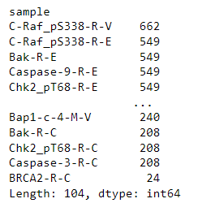
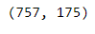
1. Preprocessing
1.2. Data Cleaning
No duplicates found
Handled Null Values
Found 104 null values containing features
Dropped those features
Then shape of the dataset
No considerable zero values found in each feature
20

Slide 21
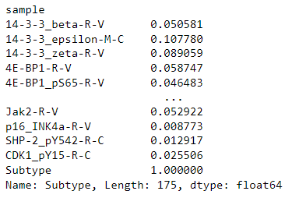
1. Preprocessing
1.3. Feature Selection ( Pearson Correlation )
Got the correlation of each features with label
Selected the best features (140, 120, 100, 50 and 20) considering the highest correlations
21

Slide 22

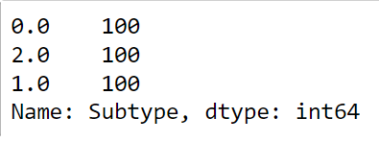
1. Preprocessing
1.4. Sampling ( Up sampling and Down sampling )
Used both techniques to equalize the value count of subtype (label)
Before sampling
After sampling
22

Slide 23
1. Preprocessing
1.5 Splitting Data ( Train | Test )
Have used sklearn’s, train_test_split method to split the data as train and test
Ratio between train and test = 4:1
Splitting has done for;
Main dataset
Datasets with different number of features ( 5 )
23

Slide 24
1. Preprocessing
1.6. Data Transformation
Dataset is not in a standard range
To solve that we used Standardization
24

Slide 25
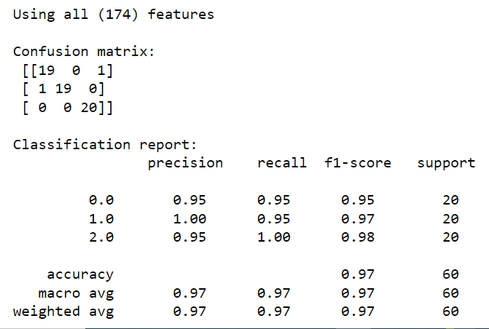
2. Train the models and evaluation
Prediction method: SVM
Evaluation method: confusion matrix and classification report
25

Slide 26
3. Results for Protein data (Upto now)
Feature selection method: Pearson Correlation
Prediction method: SVM
Evaluation method: Accuracy and f1-Score
No of features | Accuracy | F1-Score
 |  | KIRC | KIRP | KICH
All (174) | 0.97 | 0.95 | 0.97 | 0.98
140 | 0.97 | 0.95 | 0.97 | 0.98
120 | 0.95 | 0.95 | 0.97 | 0.93
100 | 1.00 | 1.00 | 1.00 | 1.00
50 | 0.99 | 0.99 | 1.00 | 0.99
20 | 0.93 | 0.91 | 0.95 | 0.94
26

Slide 27
Future Works

Slide 28
Omic type
protein expression
gene expression
DNA methylation
miRNA
Feature selection methods
Pearson Correlation
Forward feature selection
Backward feature elimination
No. of features
All
100
50
20
Prediction Methods
SVM
KNN
RF
.
.
.
Best Feature Selection method with least no. of features + Best Prediction Method
28

Slide 29
O/P 1
O/P 2
Target
O/P 3
O/P 4
How our model works
29

Slide 30

Workplan
 | ^{Semester 06} |  |  |  |  |  | ^{Semester 07} |  |  |  | ^{Semester 08}
 | w01 | w06 | w09 | w10 | w18 | w20 | w01 | w03 | w09 | w16 | w01 | w03 | w08
Literature review
Bibliography writing
Data collection
Research Proposal writing
Data preparation
Model implementation
Finalize the model
Research Report writing
Research paper writing
30

Slide 31
References
Muhamed Ali, Ali, Hanqi Zhuang, Ali Ibrahim, Oneeb Rehman, Michelle Huang, and Andrew Wu. 2018. "A Machine Learning Approach for the Classification of Kidney Cancer Subtypes Using miRNA Genome Data" Applied Sciences 8, no. 12: 2422. https://doi.org/10.3390/app8122422
Marquardt, André et al. “Subgroup-Independent Mapping of Renal Cell Carcinoma-Machine Learning Reveals Prognostic Mitochondrial Gene Signature Beyond Histopathologic Boundaries.” Frontiers in oncology vol. 11 621278. 15 Mar. 2021, doi:10.3389/fonc.2021.621278
Eloise Withnell, Xiaoyu Zhang, Kai Sun, Yike Guo, XOmiVAE: an interpretable deep learning model for cancer classification using high-dimensional omics data, Briefings in Bioinformatics, Volume 22, Issue 6, November 2021, bbab315, https://doi.org/10.1093/bib/bbab315
Lovino, M., Bontempo, G., Cirrincione, G., Ficarra, E. (2020). “Multi-omics Classification on Kidney Samples Exploiting Uncertainty-Aware Models”. In: Huang, DS., Jo, KH. (eds) Intelligent Computing Theories and Application. ICIC 2020. Lecture Notes in Computer Science (), vol 12464. Springer, Cham. https://doi.org/10.1007/978-3-030-60802-6_4
Hu F, Zeng W, Liu X. A Gene Signature of Survival Prediction for Kidney Renal Cell Carcinoma by Multi-Omic Data Analysis. International Journal of Molecular Sciences. 2019; 20(22):5720. https://doi.org/10.3390/ijms20225720
31

Slide 32
References
He, Z., Liu, H., Moch, H. et al. Machine learning with autophagy-related proteins for discriminating renal cell carcinoma subtypes. Sci Rep 10, 720 (2020). https://doi.org/10.1038/s41598-020-57670-y
Eliana Marostica, Rebecca Barber, Thomas Denize, Isaac S. Kohane, Sabina Signoretti, Jeffrey A. Golden, Kun-Hsing Yu; Development of a Histopathology Informatics Pipeline for Classification and Prediction of Clinical Outcomes in Subtypes of Renal Cell Carcinoma. Clin Cancer Res 15 May 2021; 27 (10): 2868–2878. https://doi.org/10.1158/1078-0432.CCR-20-4119
Wu J, Jin S, Gu W, Wan F, Zhang H, Shi G, Qu Y and Ye D (2019) Construction and Validation of a 9-Gene Signature for Predicting Prognosis in Stage III Clear Cell Renal Cell Carcinoma. Front. Oncol. 9:152. doi: 10.3389/fonc.2019.00152
Terrematte, P.; Andrade, D.S.; Justino, J.; Stransky, B.; de Araújo, D.S.A.; Dória Neto, A.D. A Novel Machine Learning 13-Gene Signature: Improving Risk Analysis and Survival Prediction for Clear Cell Renal Cell Carcinoma Patients. Cancers 2022, 14, 2111. https://doi.org/10.3390/cancers14092111
Huang, Jennifer J, and James J Hsieh. “The Pan-Omics Landscape of Renal Cell Carcinoma and Its Implication on Future Clinical Practice.” Kidney cancer (Clifton, Va.) vol. 4,3 121-129. 16 Sep. 2020, doi:10.3233/KCA-200085
32

Slide 33
References
https://www.javatpoint.com/feature-selection-techniques-in-machine-learning
https://www.javatpoint.com/classification-algorithm-in-machine-learning
33

Slide 34
Thank You!

